Slide 1

Perfect Your

Slide 2

What is an ELEVATOR PITCH?
It’s the RIGHT INFORMATION delivered to
An IMPORTANT AUDIENCE
in the TIME it takes to ride an elevator
from one floor to another.

Slide 3
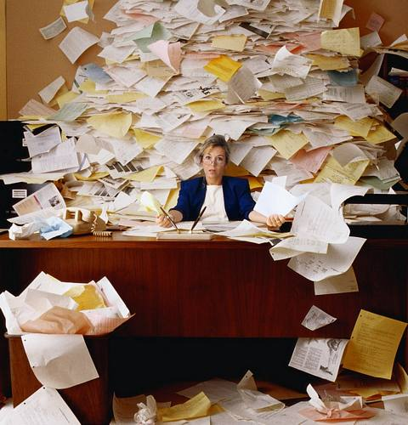
Why Do You Need an Elevator Pitch?
AUDIENCES ARE
OVERWHELMED
with CLUTTER and have
NO TIME, and
LESS ATTENTION.

Slide 4

Business people are receiving 150 e-mails EVERY DAY.

Slide 5
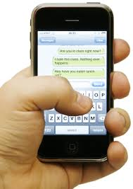
Business people are receiving 30 Text Message EVERY DAY.

Slide 6

“...we are bombarded with as many as 5000 or more messages every day.” (Yankelovich)
“84% of us cannot go without our cell phones for a single day. 50% of us sleep with our cell phone (including 80% of 18-24 year olds). 20% of us check our phone every 10 minutes.”
(Time Magazine)

Slide 7
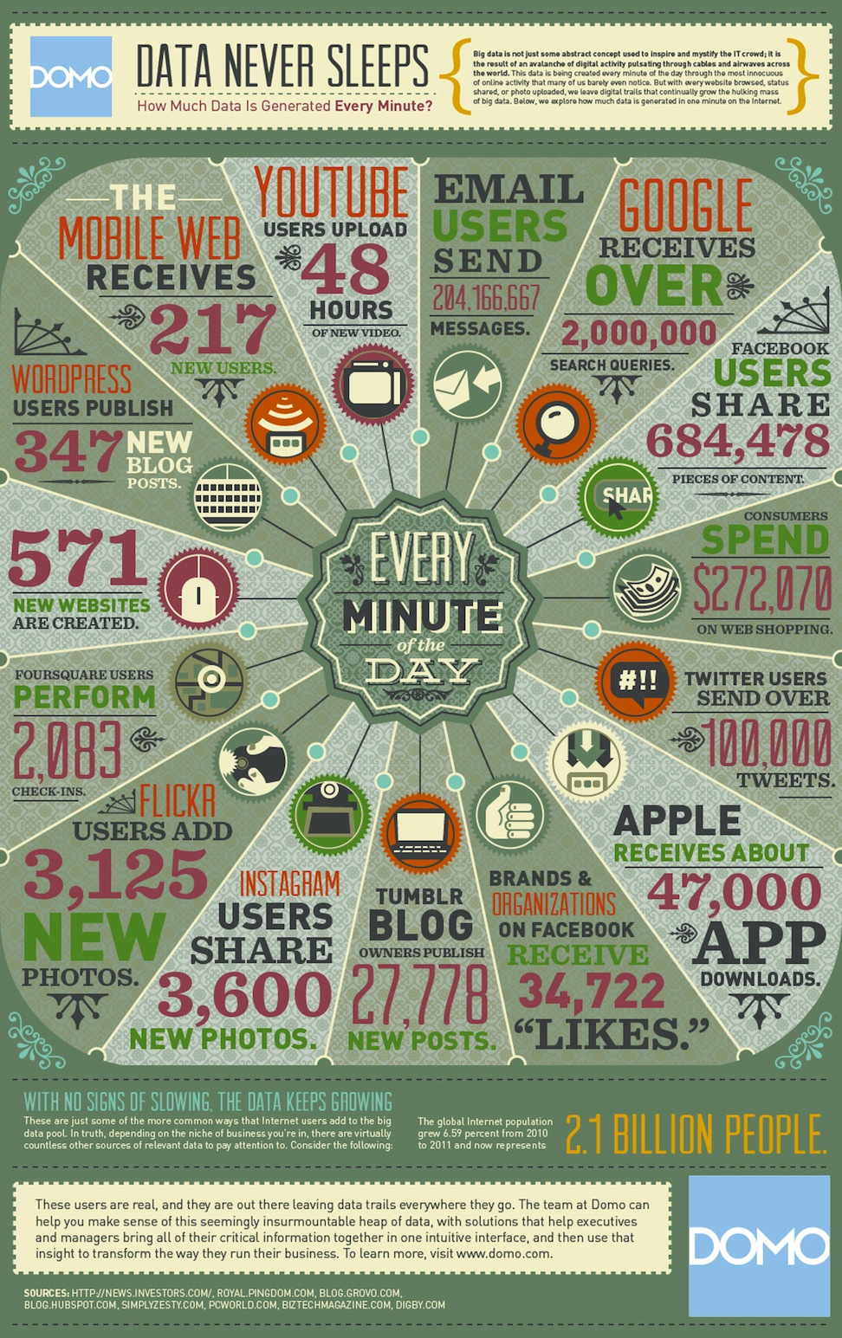
Data NEVER sleeps.

Slide 8
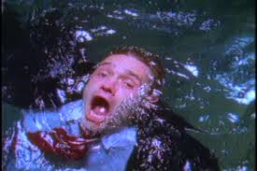
“We are drowning in information and starving for knowledge.” Rutherford Rogers, Yale Librarian

Slide 9

“What information consumes is rather obvious: it consumes the attention of its recipients.
Hence, a wealth of information creates a poverty of attention.”
Herb Simon, CMU, Nobel Laureate

Slide 10

We ALL suffer from “Infobesity.”

Slide 11
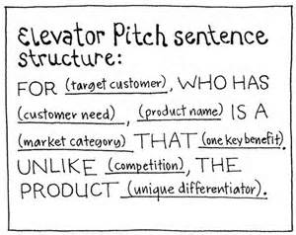
As a result, we must seat information quickly and efficiently in the minds of our audiences in an ELEVATOR PITCH.
Here’s a formula

Slide 12

The ED BARR Elevator Pitch
For university programs whose students don’t communicate well, Ed Barr is a Communication Coach who creates measureable improvements in writing and speaking unlike most teachers because he has taught communication skills all over the world (China, India, Kazakhstan, Great Britain, Europe and Latin America) and has had a successful career in marketing. Can I contact you to talk about your needs?

Slide 13
OR,
Hi, I’m Ed Barr. I teach people how to write and speak more effectively using seven techniques I have mastered over a lifetime of teaching around the world at CMU and through my business experiences as a marketing executive. I can bring you measureable improvements quickly. Can I have your business card and connect on LinkedIn?

Slide 14

Remember to state a benefit and differentiate yourself!

Slide 15

Now YOU try! Write your

